Slide 1


PROJECT
RFID/NFC Access Control System with User Differentiation.

Slide 2
Group members
M S Rishikesh 12100950 Gaurav Mahatha 12114622
Rahul yadav 12101065
Bishal chandra 12111480

Slide 3


Objective
The real-life objective of this project is to enhance security and convenience in access control scenarios, such as homes, offices, or any location requiring restricted entry. By implementing RFID/NFC technology, the system ensures that only authorized individuals can gain access. The differentiation of users through unique cards offers tailored access rights, making it suitable for various user categories like employees, visitors, or invalid users. The visual and auditory feedback mechanisms not only confirm access but also provide a clear signal for user category recognition, adding an additional layer of security and user-friendliness. The integration of a micro servo enhances the physical access control aspect, ensuring that the door is only opened for authorized individuals. In real-life applications, this project can significantly improve security and access management, making it a valuable asset in various environments.

Slide 4



Components Used
Raspberrypi
RFID Read/Write Module (RC522) RFID Card & NFC tags
Bread board
LED’s
Buzzer Micro Servo
Jumper wires

Slide 5

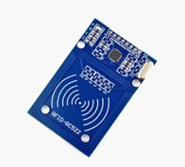
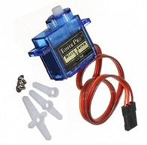
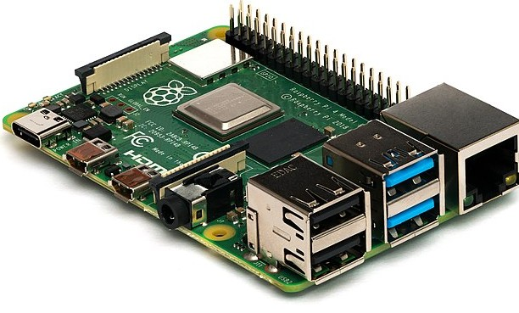


RFID Read/Write Module (RC522)
MICRO SERVO
raspberry pi
Raspberry Pi is a small, affordable, single-board computer.
It's popular for DIY projects, education, and embedded systems.
It runs on various operating systems and is known for its versatility.
The RFID RC522 module is a popular, low- cost device for reading and writing RFID
cards and tags, ideal for applications such as access control, inventory management, and automation projects. It communicates over SPI and offers robust functionality in a
compact package.
A micro servo is a small, lightweight, and
precise electric motor-driven device commonly used for controlling the position of various components in applications like robotics and remote- controlled systems.

Slide 6
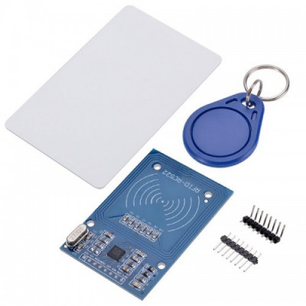
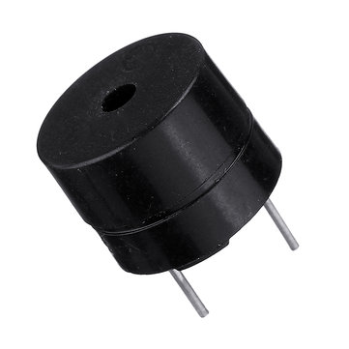
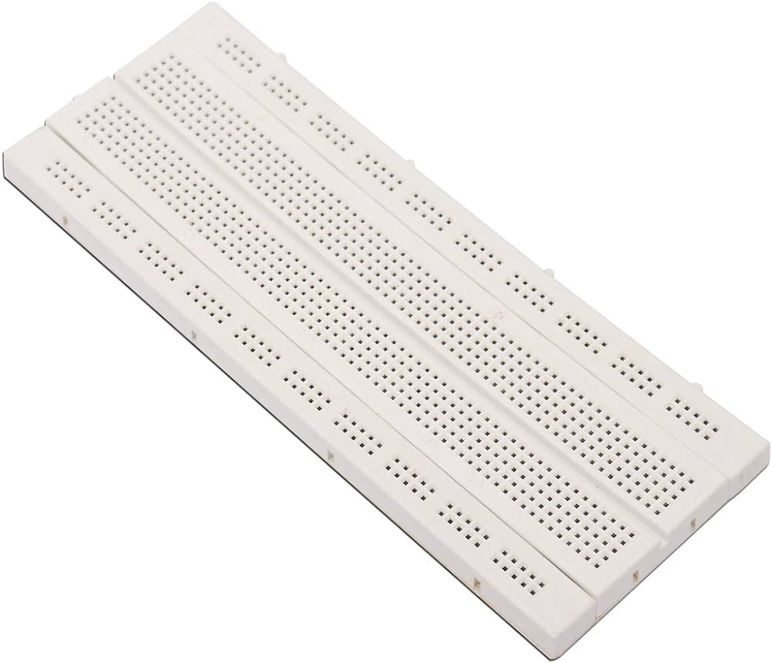
RFID Card & NFC tags
Buzzer
breadboard
A buzzer is an electrical component that generates sound when voltage is applied.
It's commonly used in electronic devices and alarms to produce audible alerts or tones
A breadboard is a prototyping tool used in electronics to create temporary circuits. It consists of a grid of holes for inserting and connecting electronic components. Breadboards allow for experimentation without soldering, making them ideal for quick and reversible circuit design.
RFID cards are passive devices that use radio waves for identification and data transfer, commonly used in access control and inventory management.
NFC tags are a subset of RFID, enabling short-range wireless communication, often employed in smartphones for mobile payments, data sharing, and automation tasks.

Slide 7


working of
project
"In this project, we've integrated a Raspberry Pi with an RFID Read/Write Module (RC522), a breadboard, LEDs, a buzzer, a micro servo, NFC tags, jumper wires, and the concept of blinking to create a secure access control system.
Upon starting the project, a prompt on a connected phone instructs the user to present their RFID card or NFC tag. The system is equipped with five distinct cards: three for entry, one for exit, and one for invalid users. Each card corresponds to a specific user or category.
When a user places their card on the reader, it triggers the system to open a door using the micro servo motor. Simultaneously, an LED associated with the user's card illuminates, providing a visual indication of the user's category. Additionally, a buzzer generates an audible signal to further confirm the card's status.
This project effectively manages access control through RFID/NFC technology, ensuring a secure and user-friendly experience while differentiating between valid and invalid users."

Slide 8

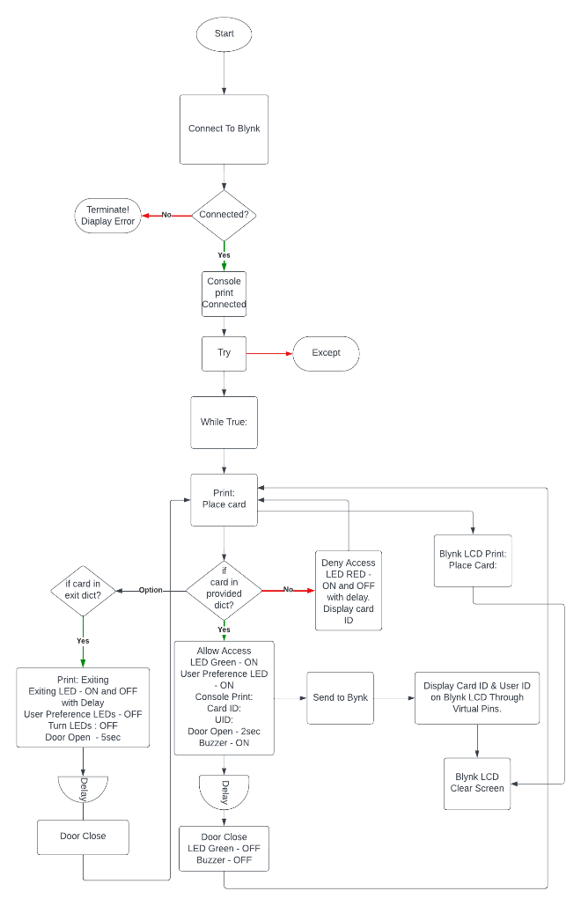

Flowchart

Slide 9
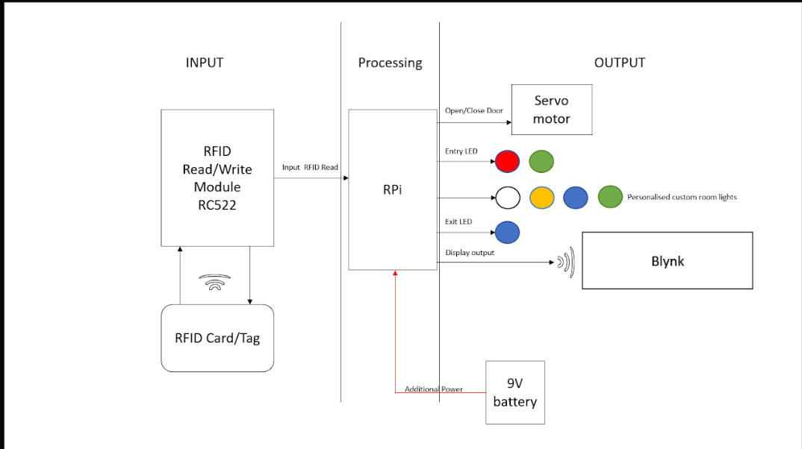
Block Diagram

Slide 10
Code :
import RPi.GPIO as GPIO
import time
from mfrc522 import SimpleMFRC522
import BlynkLib
from BlynkTimer import BlynkTimer
# Define Constants
AUTHORIZED_CARDS = {
152900158326: ("Rahul", 5),
427472077813: ("Gaurav", 6),
152763515803: ("Bishal", 13),
978622562824: ("Rishikesh", 19),
}
EXIT_CARDS = {
635628044877: ("Exit", 4)
}
# Other Constants
LED_PIN = 0
LED_GREEN = 17
RED_LED_DENIED = 27
SERVO_PIN = 23
BUZZER_PIN = 22
LED_PINS = [5, 6, 13, 19]
EXIT_LED = 4
# Initialize Blynk
BLYNK_AUTH_TOKEN = "X5Bho--zseF_Cc9h1OKzbr_FIlqiY_Ab"
blynk = BlynkLib.Blynk(BLYNK_AUTH_TOKEN)
# Create BlynkTimer Instance
timer = BlynkTimer()
# Function to sync the data from virtual pins
@blynk.on("connected")
def blynk_connected():
print("Hi, You have Connected to New Blynk2.0")
print(".......................................................")
time.sleep(0.5)
def myData():
blynk.virtual_write(0, "Place Card: ")
def handle_authorized_access(card_id):
user, led_pin = AUTHORIZED_CARDS[card_id]
print("Access granted!")
print("Welcome", user)
blynk.virtual_write(0, "ID: " + str(card_id))
blynk.virtual_write(1, "Welcome:" + str(user))
# Turn on the corresponding LED
GPIO.output(led_pin, GPIO.HIGH)
GPIO.output(LED_GREEN, GPIO.HIGH)
GPIO.output(BUZZER_PIN, GPIO.HIGH)
pwm.ChangeDutyCycle(2.5)
time.sleep(2)
pwm.ChangeDutyCycle(7.5)
blynk.virtual_write(1, " ")
time.sleep(2)

Slide 11
Code :
# Turn off the LED
GPIO.output(LED_GREEN, GPIO.LOW)
GPIO.output(BUZZER_PIN, GPIO.LOW)
def handle_exit(card_id):
user, led_pin = EXIT_CARDS[card_id]
print("Exiting!")
blynk.virtual_write(0, "Exiting: ")
for led in LED_PINS:
GPIO.output(led, GPIO.LOW)
GPIO.output(EXIT_LED, GPIO.HIGH)
pwm.ChangeDutyCycle(2.5)
time.sleep(5)
pwm.ChangeDutyCycle(7.5)
time.sleep(0.5)
GPIO.output(EXIT_LED, GPIO.LOW)
def handle_access_denied(card_id):
print("Access denied!")
blynk.virtual_write(0, "ID: " + str(card_id))
blynk.virtual_write(1, "Access Denied! ")
GPIO.output(RED_LED_DENIED, GPIO.HIGH)
GPIO.output(BUZZER_PIN, GPIO.HIGH)
time.sleep(0.2)
GPIO.output(RED_LED_DENIED, GPIO.LOW)
GPIO.output(BUZZER_PIN, GPIO.LOW)
time.sleep(0.2)
GPIO.output(RED_LED_DENIED, GPIO.HIGH)
GPIO.output(BUZZER_PIN, GPIO.HIGH)
time.sleep(0.5)
GPIO.output(RED_LED_DENIED, GPIO.LOW)
blynk.virtual_write(1, " ")
# Set up GPIO
GPIO.setmode(GPIO.BCM)
GPIO.setup(LED_PIN, GPIO.OUT)
GPIO.setup(RED_LED_DENIED, GPIO.OUT)
GPIO.setup(BUZZER_PIN, GPIO.OUT)
GPIO.setup(SERVO_PIN, GPIO.OUT)
GPIO.setup(LED_GREEN, GPIO.OUT)
for led in LED_PINS:
GPIO.setup(led, GPIO.OUT)
GPIO.setup(EXIT_LED, GPIO.OUT)
# Create PWM object for the servo
pwm = GPIO.PWM(SERVO_PIN, 50)
pwm.start(0)
reader = SimpleMFRC522()
timer.set_interval(2, myData)
if __name__ == "__main__":
try:
while True:
blynk.run()
timer.run()
id, text = reader.read()
print("Card ID:", id)
if id in AUTHORIZED_CARDS:
handle_authorized_access(id)
elif id in EXIT_CARDS:
handle_exit(id)
else:
handle_access_denied(id)
except KeyboardInterrupt:
print("Keyboard interrupt detected. Stopping the program.")
GPIO.cleanup()
pwm.stop()

Slide 12

APPLICATIONS OF PROJECT
Home Security: Implementing this system at home can enhance security by allowing authorized family members seamless access while preventing unauthorized entry.
Schools and Universities: Enhance campus security by limiting access to authorized students and staff while keeping track of visitor entries.
Parking Lots and Garages: Use the system for secure parking lot access, granting entry to registered vehicles only.
Data Centers: Secure server rooms and data centers by restricting access to authorized personnel only.
Hotels and Hospitality: Use the system to control room access for guests and staff, enhancing overall security and service.
Customized Access Scenarios: The system can be adapted to various applications where controlled access is required, including club entrances, sports venues, and more.

Slide 13
Benefits
User Differentiation: The system can distinguish between different user categories, such as employees, visitors, and invalid users, allowing for customized access rights
Versatility: The system can be applied to various sectors, including residential, commercial, industrial, and public spaces.
Enhanced Security: The system provides a robust and secure method of access control, ensuring that only authorized individuals can gain entry.
Reduced Administrative Overhead: By automating access control, the system reduces the need for manual security checks and supervision

Slide 14


THANK YOU
Conclusion
In conclusion, the RFID/NFC Access Control System with user differentiation presents an effective and versatile solution for enhancing security, access control, and user experience in various real-world settings. By seamlessly integrating RFID/NFC technology, visual and auditory feedback mechanisms, and physical access control, this project offers a comprehensive approach to managing and monitoring access. The ability to differentiate between user categories and customize access rights adds an extra layer of functionality and security. Whether deployed in homes, offices, schools, or any location requiring controlled access, this system provides an invaluable tool for improving safety, convenience, and administrative efficiency. Its scalability, cost-effectiveness, and adaptability make it a practical choice for a wide range of applications. In summary, this project exemplifies how modern technology can be harnessed to create solutions that address critical needs in today's security-conscious world.

